Slide 1
MATLAB Programming
Final Exam One
Instructor: 黃世強 (Sai-Keung Wong)

Slide 2
Content
There are two problems. You must answer all of them.
You can create new files for functions.

Slide 3
About demo video and demo programs.
A demo video or a demo program may have bugs. They show or illustrate roughly the results. These results may not be exactly the same as the requirements. They are for your own reference. You must follow the instruction to finish your programs.

Slide 4
Program file name format
Write all your programs in a folder. The folder name is mat_exam_01_student_ID. For example, if your ID is 12345678, the folder name is mat_exam_01_12345678.
Zip the folder and upload it.
Write a program for each problem in one file.
The file name is ex01_X_yourStudentID.m, where X is the problem number.
For example, if your student ID is 12345678 and the problem number is 3, then the file name must be ex01_3_12345678.m.
You must not output all the intermediate results.
Output the results that are required only.

Slide 5
File content header
At the top of the file, write down your name, ID, email address, department, and date. If you do not do so, you receive a score of zero in the corresponding problem.
%%%%%%%%%%%%%%%%%%%%%%%%%%%
% Final Exam Number: …
% Problem number: …
% Student Name: …
% Student ID: …
% Email address: …
% Department:
% Date: ….
%%%%%%%%%%%%%%%%%%%%%%%%%%%%

Slide 6
File content
For each problem, display the problem number before showing the results.
close all; clear; clc; % close all windows
% clear variables, and clear screen
disp('Exam Problem 1.1') % show Exam Problem 1.1

Slide 7
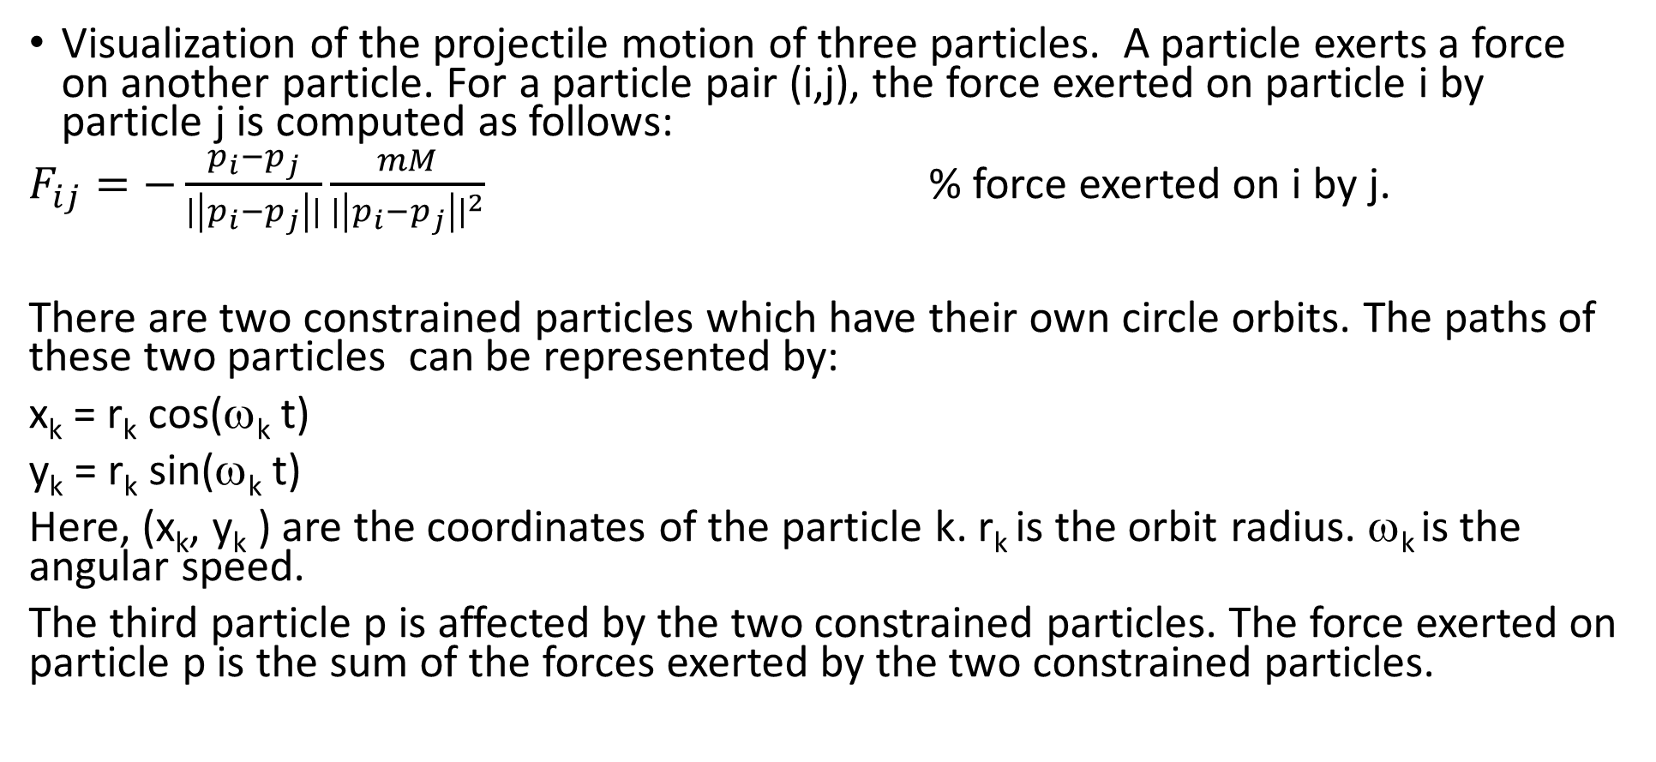
(50%) Problem 1.1. Constrained Three-Body Problem
Visualization of the projectile motion of three particles. A particle exerts a force on another particle. For a particle pair (i,j), the force exerted on particle i by particle j is computed as follows:
$F_{ij}=−\frac{p_{i}−p_{j}}{|\left|p_{i}−p_{j}\right||}\frac{mM}{{|\left|p_{i}−p_{j}\right||}^{2}}$ % force exerted on i by j.
There are two constrained particles which have their own circle orbits. The paths of these two particles can be represented by:
x_{k} = r_{k} cos(ω_{k} t)
y_{k} = r_{k} sin(ω_{k} t)
Here, (x_{k}, y_{k} ) are the coordinates of the particle k. r_{k} is the orbit radius. ω_{k} is the angular speed.
The third particle p is affected by the two constrained particles. The force exerted on particle p is the sum of the forces exerted by the two constrained particles.

Slide 8
Problem 1.1. Constrained Three-Body Problem
Implement a program to visualize the motion of the three particles in two different settings.
G = 47.3, m = 1.
r1 = 50. r2 = 200.
Setting One
w1 = 0.5; w2 = 0.5; % angular speed of the two constrained particles
M1 = 13900; M2 = 19900; % mass of the two constrained particles
Setting Two
w1 = 0.8; w2 = 0.8; % angular speed of the two constrained particles
M1 = 15500; M2 = 16000; % mass of the two constrained particles

Slide 9
Problem 1.1. Constrained Three-Body Problem
The maximum speed of the free particle is 500.
e.g., if (norm(v)>maxv)
v = v./norm(v).*maxv;
end
Shows a gray tail of the free particle if the user sets the option. The tail is modeled by at least 100 sample points.
In both sets, show a title which has the following items:
Masses of the two constrained particles, the position and velocity of the free particle. A numeric number is shown up to two decimal places.
The title is updated each step.

Slide 10
Problem 1.1.
Use
w = 400;
axis([-w w -w w]);
pbaspect([1 1 1]);

Slide 11
Problem 1.1. The work flow
In steps 1-3, the messages must be shown properly. In steps 2 and 3, the user need to input an option.
The work flow is as follows.
1. Show a message:
Student ID: …
Student Name:….
2. Do you want to show the tail of the free particle (yes/no)? % ENTER ‘yes’ or ‘no’
3. Which format to be used for showing the systems? % ENTER 1 or 2
1) 1x2
2) 2x1
2. while true
update the two systems
show the two systems. Draw the particles with different colors, e.g., blue, red, black
show titles
until program termination

Slide 12
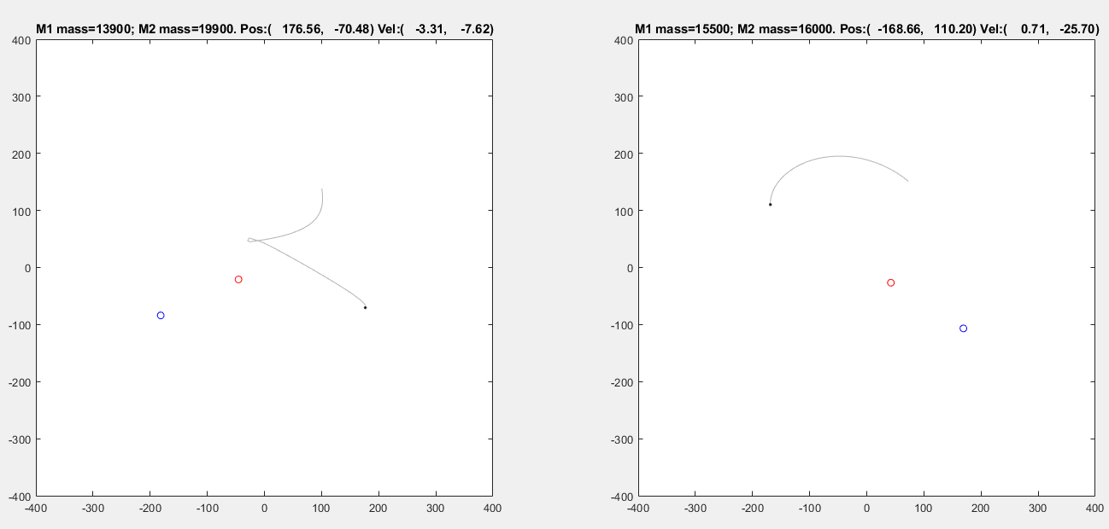
Format: 1x2

Slide 13
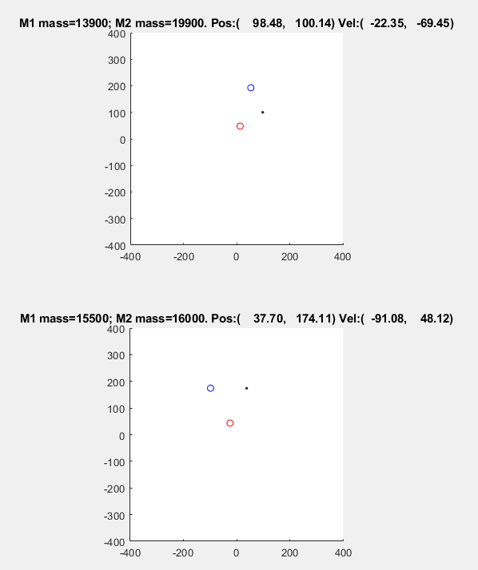
Format: 2x1. without tails

Slide 14
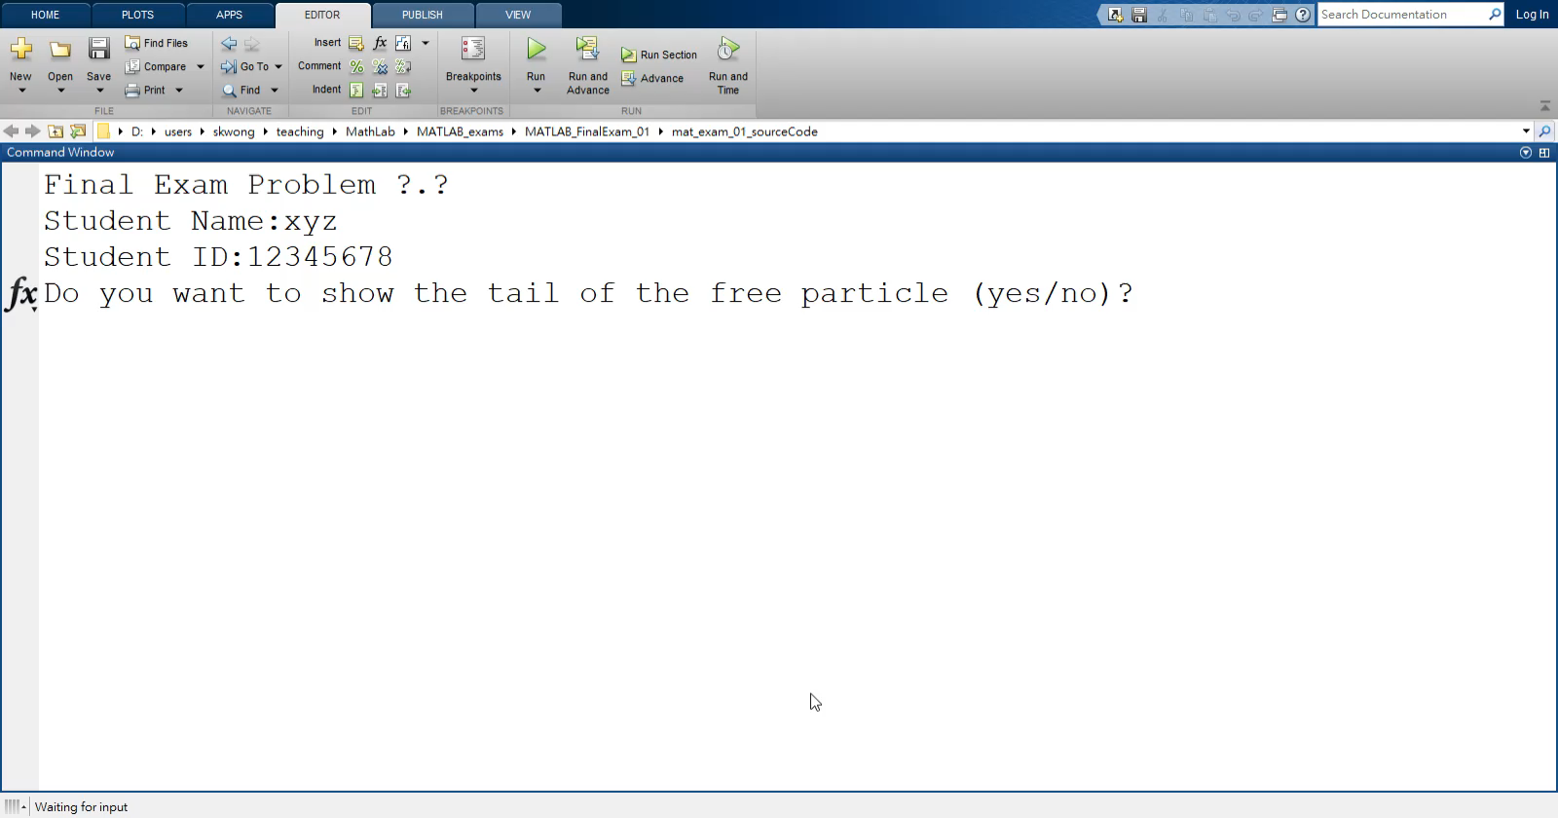
Video. Ask for input

Slide 15
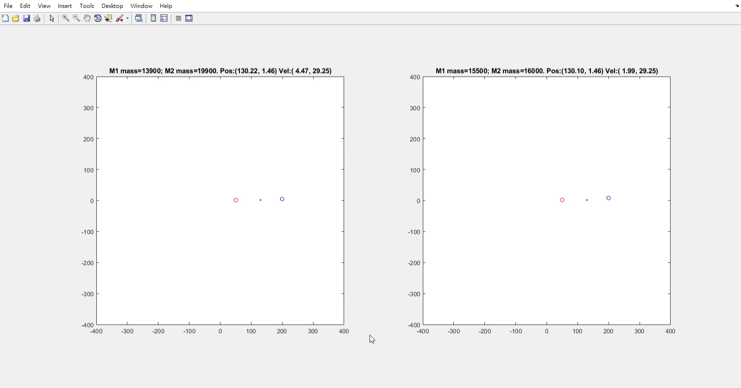
Demo video. No tails.

Slide 16

Demo video. with tails.

Slide 17
Question 1.1 Marking scheme
[2%] Show the student information.
[3%] Ask to turn off/on tails. Handle the option correctly.
[5%] Animate the system for Setting One correctly.
[7%] Animate the system for Setting Two correctly.
[10%] Animate the two systems correctly on the same figure.
[5+5%] Animate gray tails in both systems correctly.
[5%] Show the two systems in both formats 1x2 and 2x1 correctly.
[2+3%] Show the first and the second titles correctly.
[3%] Draw the three particles in different colors.

Slide 18
Question 1.1
strcmp for string comparison

Slide 19
(50%) Problem 1.2. Math Arts
Produce the results similar to the examples.
There are three options.
Handle each option correctly.
Show the message
Final Exam Problem ?.?
Student Name:xyz
Student ID:12345678
Menu
Option 1)
Option 2)
Option 3)
Please enter the option:

Slide 20
Functions
y = sin(w x), w is a scalar
y_{c} = (-1)^c y + c, c is an integer

Slide 21
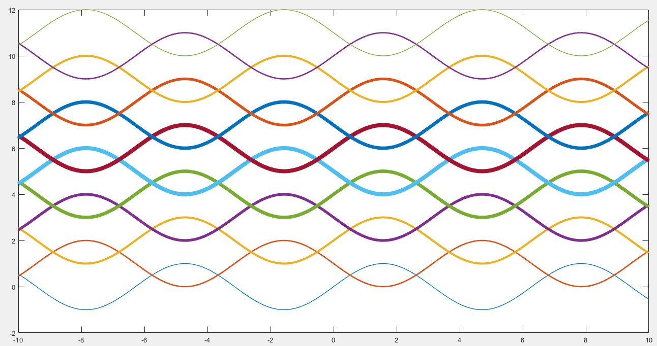
Option 1. Use sine waves. 12 curves. The thickness of the curves are increasing and then decreasing.

Slide 22
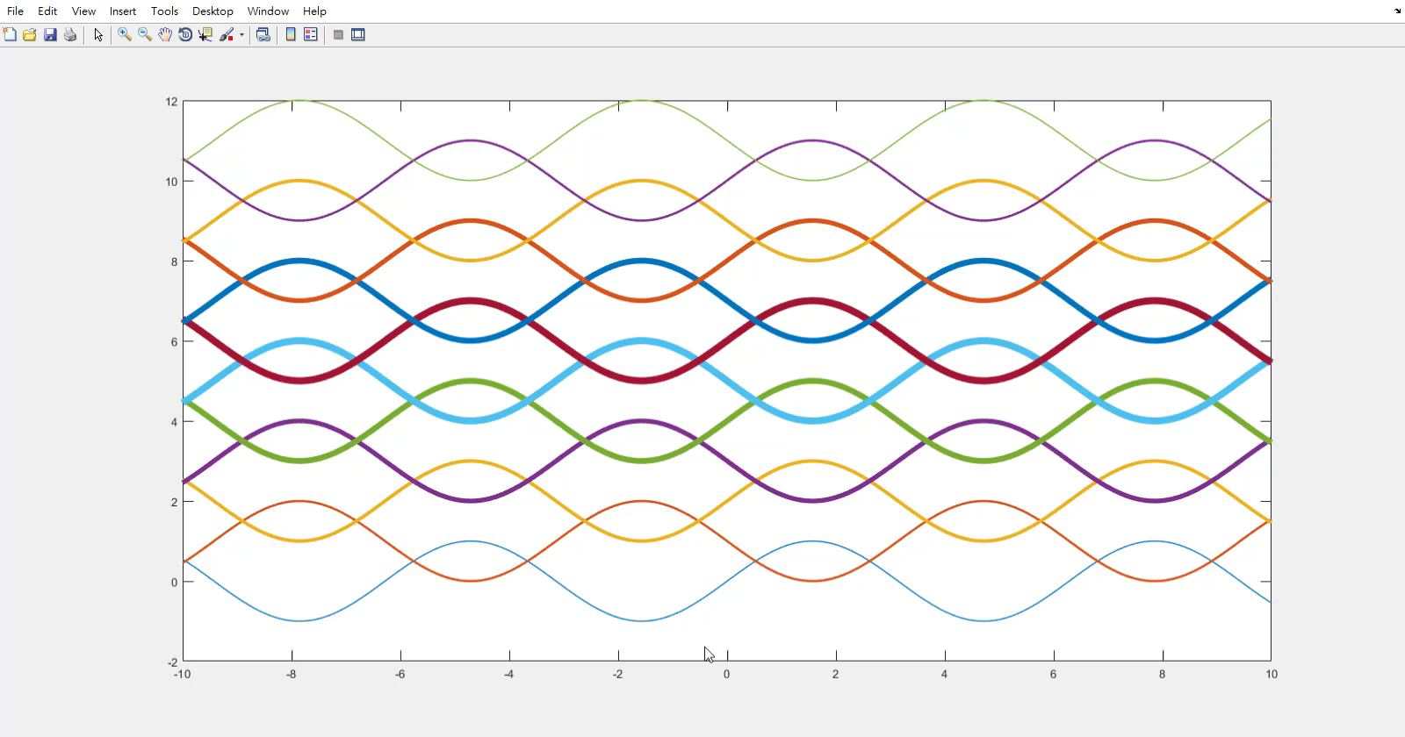
Option 1. Animation. Change the amplitude periodically.

Slide 23
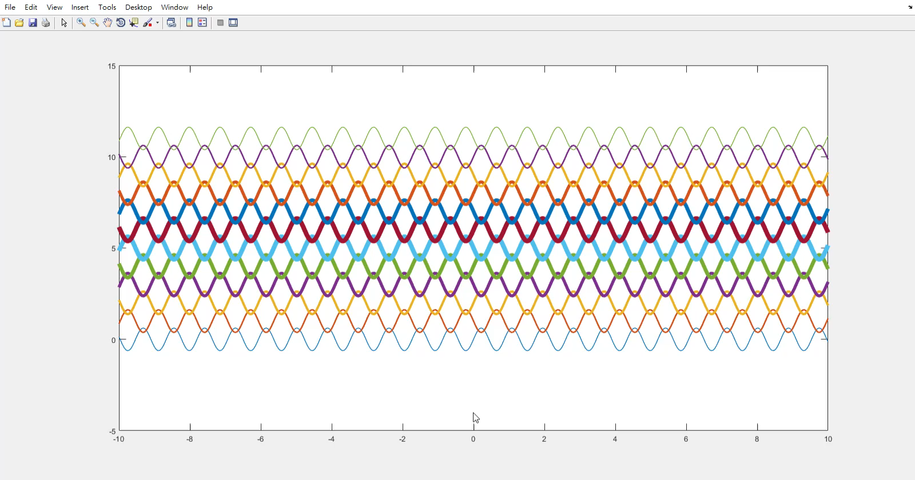
Option 2. 12 curves. Change the value of w in the functions. Also, the amplitude of the functions is proportion to w.

Slide 24
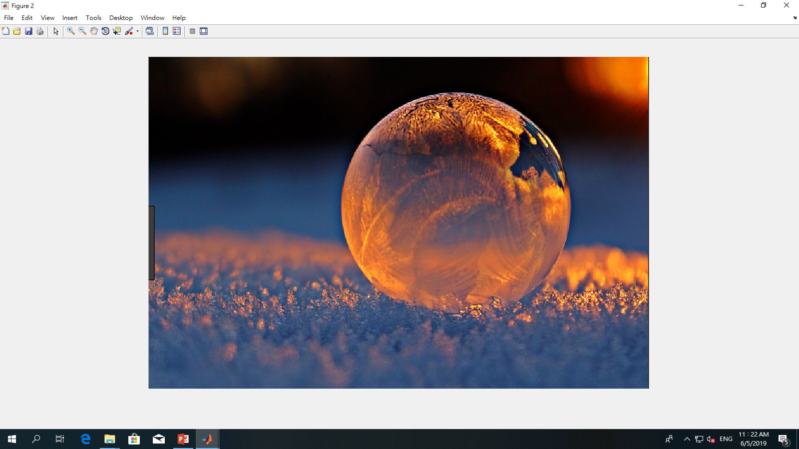
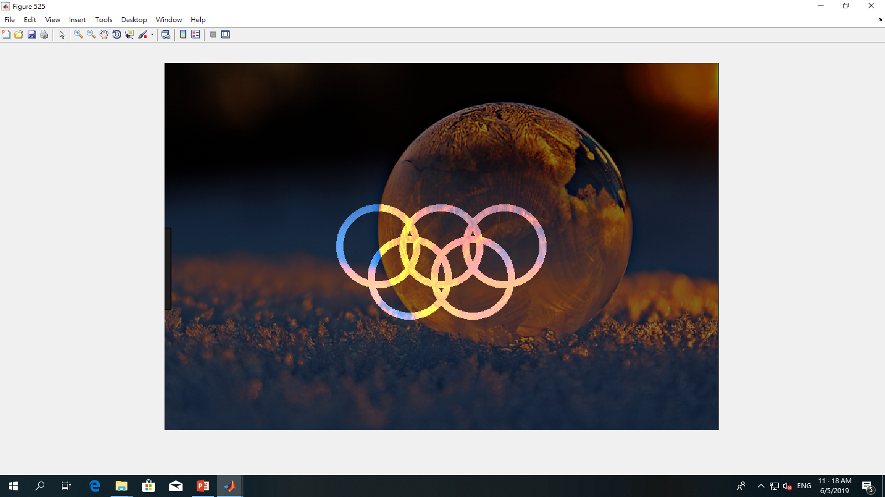
Option 3
Input image
Load an image
Create five circles with thick boundaries.
Set the brightness of pixels in the boundaries of circles higher.
Set the brightness of pixels outside of the boundaries of the circles lower.
The thickness of the circles is around 10, (i.e., 10 pixels).
There are non-overlapping regions between two overlapped circles.
result

Slide 25
Non-overlapping regions

Slide 26
Question 1.2. Marking scheme
[5%] Show the message correctly.
Option 1
[10%] The 12 curves are correct.
[10%] The animation is correct.
Option 2
[10%] The curves and animation are correct, i.e., shrinking and stretching.
Option 3
[1*5%] All circles are placed properly.
[2*5%] The brightness in all the circles and the image color are correct.

Slide 27
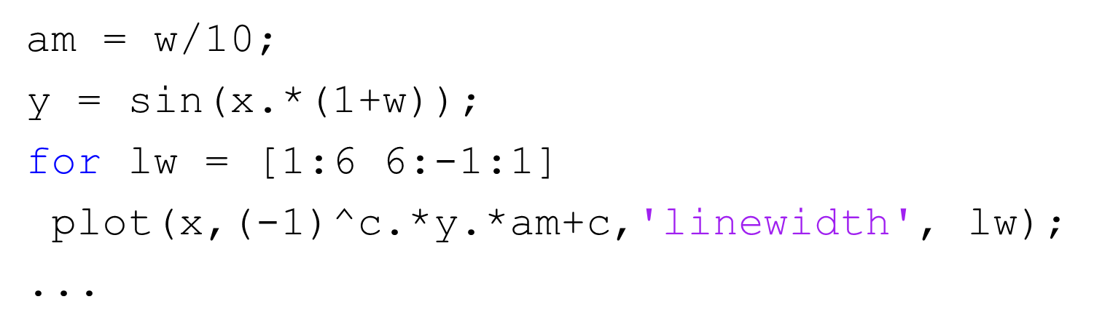
Question 1.2. Hint
This is an image. You cannot copy directly.

Slide 28
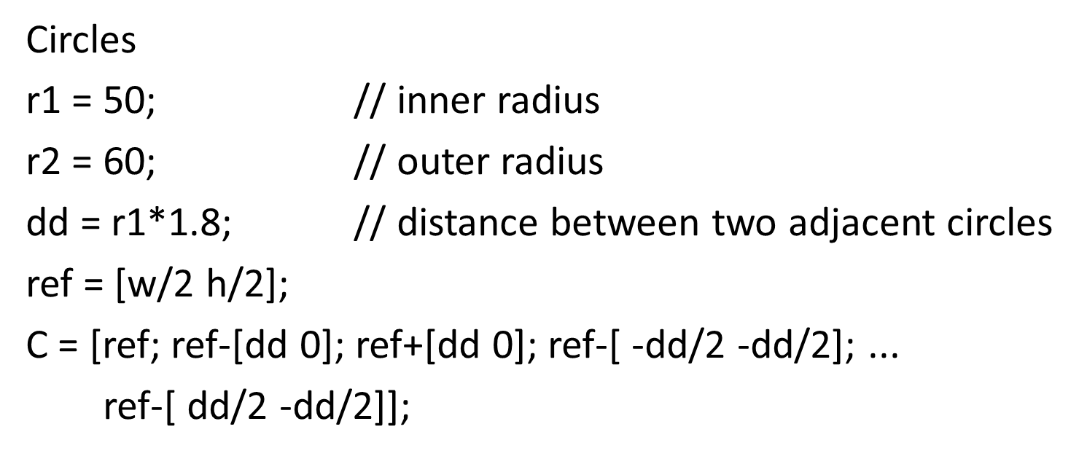
Question 1.2. Hint
This is an image. You cannot copy directly.

Slide 29
End
Enjoy MATLAB Programming.

